Slide 1

G2M Case Study
Virtual Internship
17 November 2023

Slide 2
Background –G2M(cab industry) case study
XYZ is a private firm in US. Due to remarkable growth in the Cab Industry in last few years and multiple key players in the market, it is planning for an investment in Cab industry
Objective: Help XYZ to understand the market before taking final decision.

Slide 3
Data Exploration
There is 4 data sets provided. Datasets contains records spanning from January 31, 2016, to December 31, 2018.
Cab_Data.csv – this file includes details of transaction for 2 cab companies
Customer_ID.csv – this is a mapping table that contains a unique identifier which links the customer’s demographic details
Transaction_ID.csv – this is a mapping table that contains transaction to customer mapping and payment mode
City.csv – this file contains list of US cities, their population and number of cab users

Slide 4
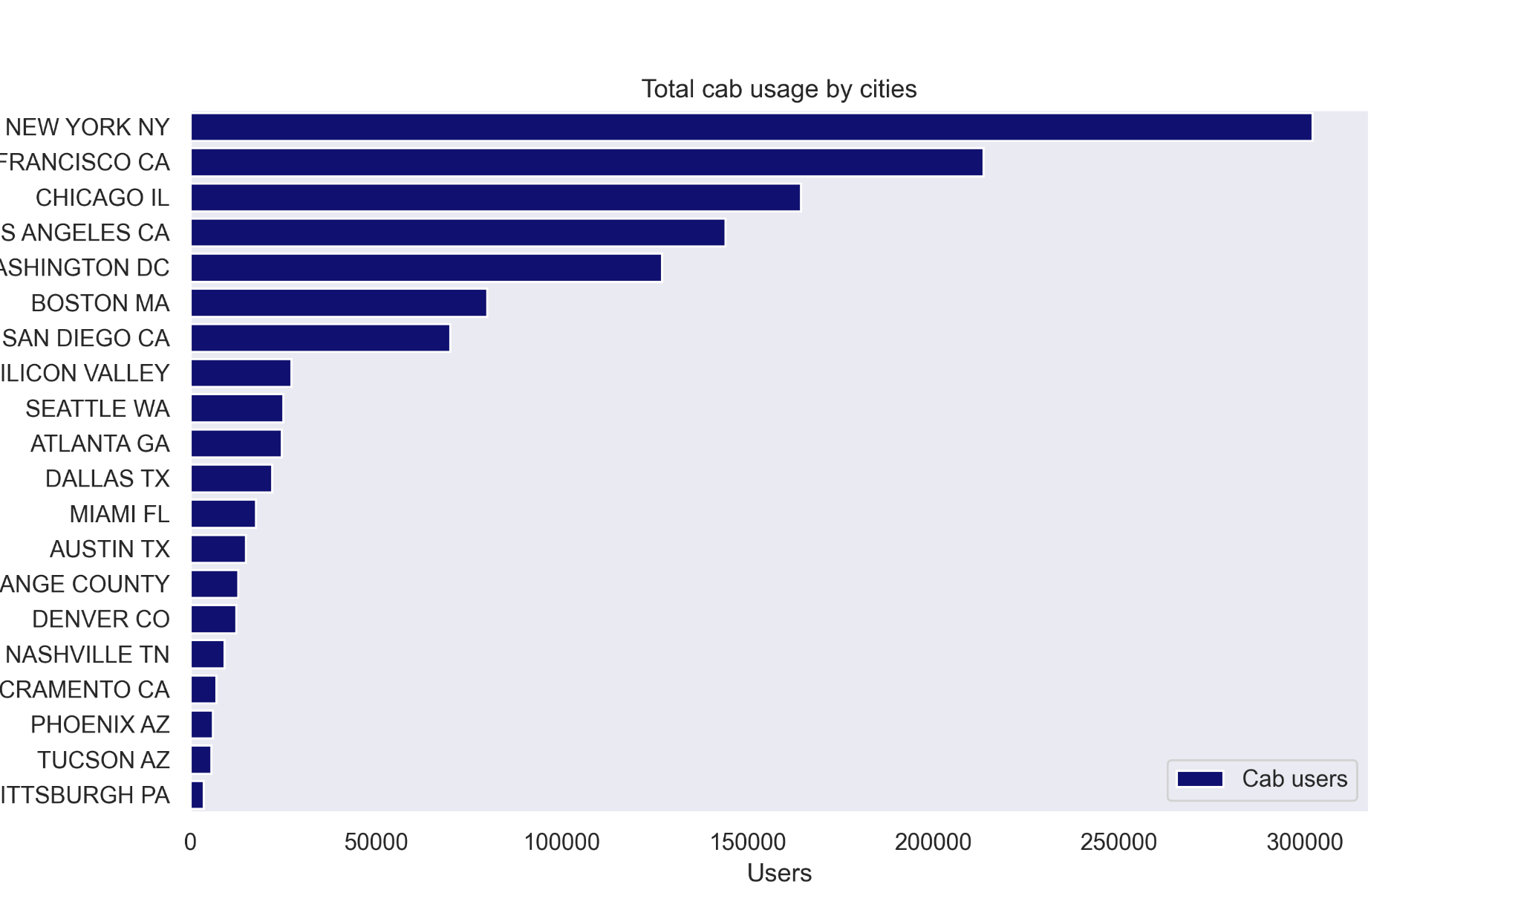
Profit Analysis
Market Analysis
The cab industry is a huge global market. Based on the data from Yellow Cab and Pink Cab, here are the leading markets for these two companies in the United States.
New York, NY, is where the cabs are most used for commuting, followed by San Francisco, CA, and Chicago, IL.

Slide 5
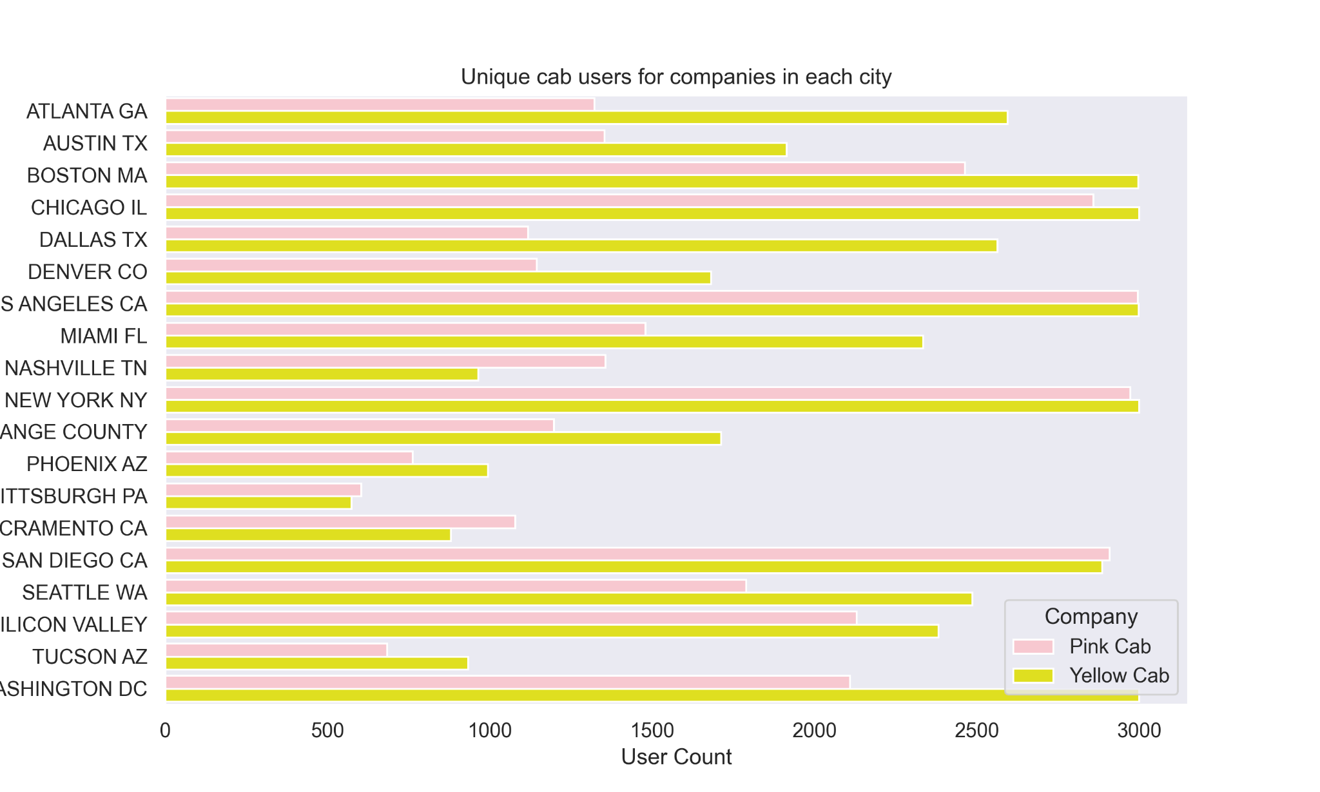
Unique users Cab Companies have by City
An analysis of the graphical data reveals that Yellow Cab and Pink Cab have nearly the same amount of unique users.

Slide 6
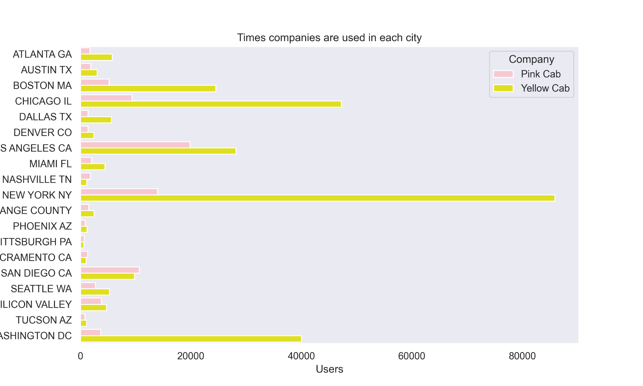
Most used Cab Companies by City
However, even though both companies have the same amount of unique users, Yellow Cab users use Yellow Cab’s services more than its competitors.
Based on the graph, Yellow Cab is the leader in markets like New York, NY, Washington, DC, and Chicago, IL.

Slide 7
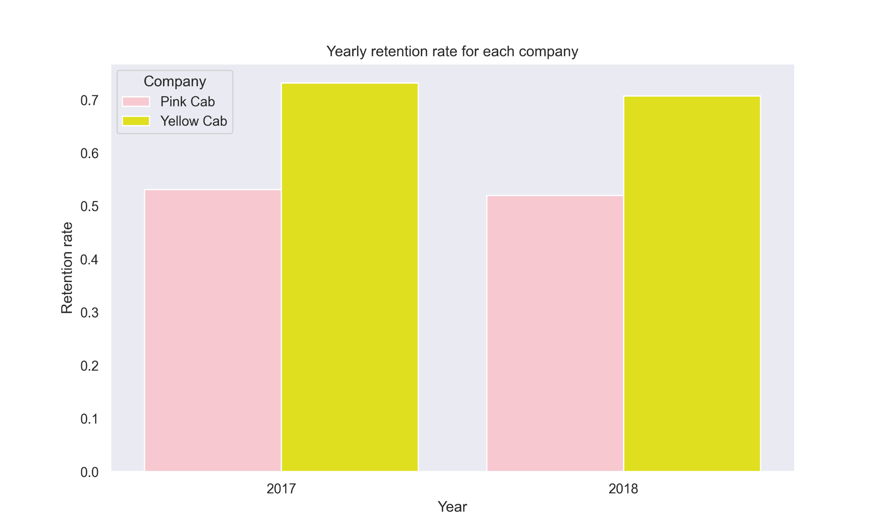
Retention rate for the each company by year
Based on the graph on the left and the previous data, we can conclude that Yellow Cab has a better user retention rate since its unique users use it more frequently than its competitors.

Slide 8
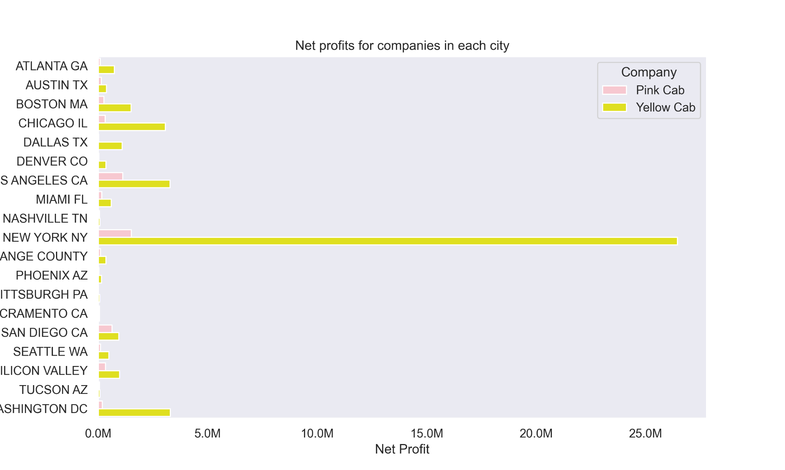
Net profits for Cab Companies by City
Since its users use Yellow Cab more often, they generate much higher profits than its competitor in nearly all markets.

Slide 9
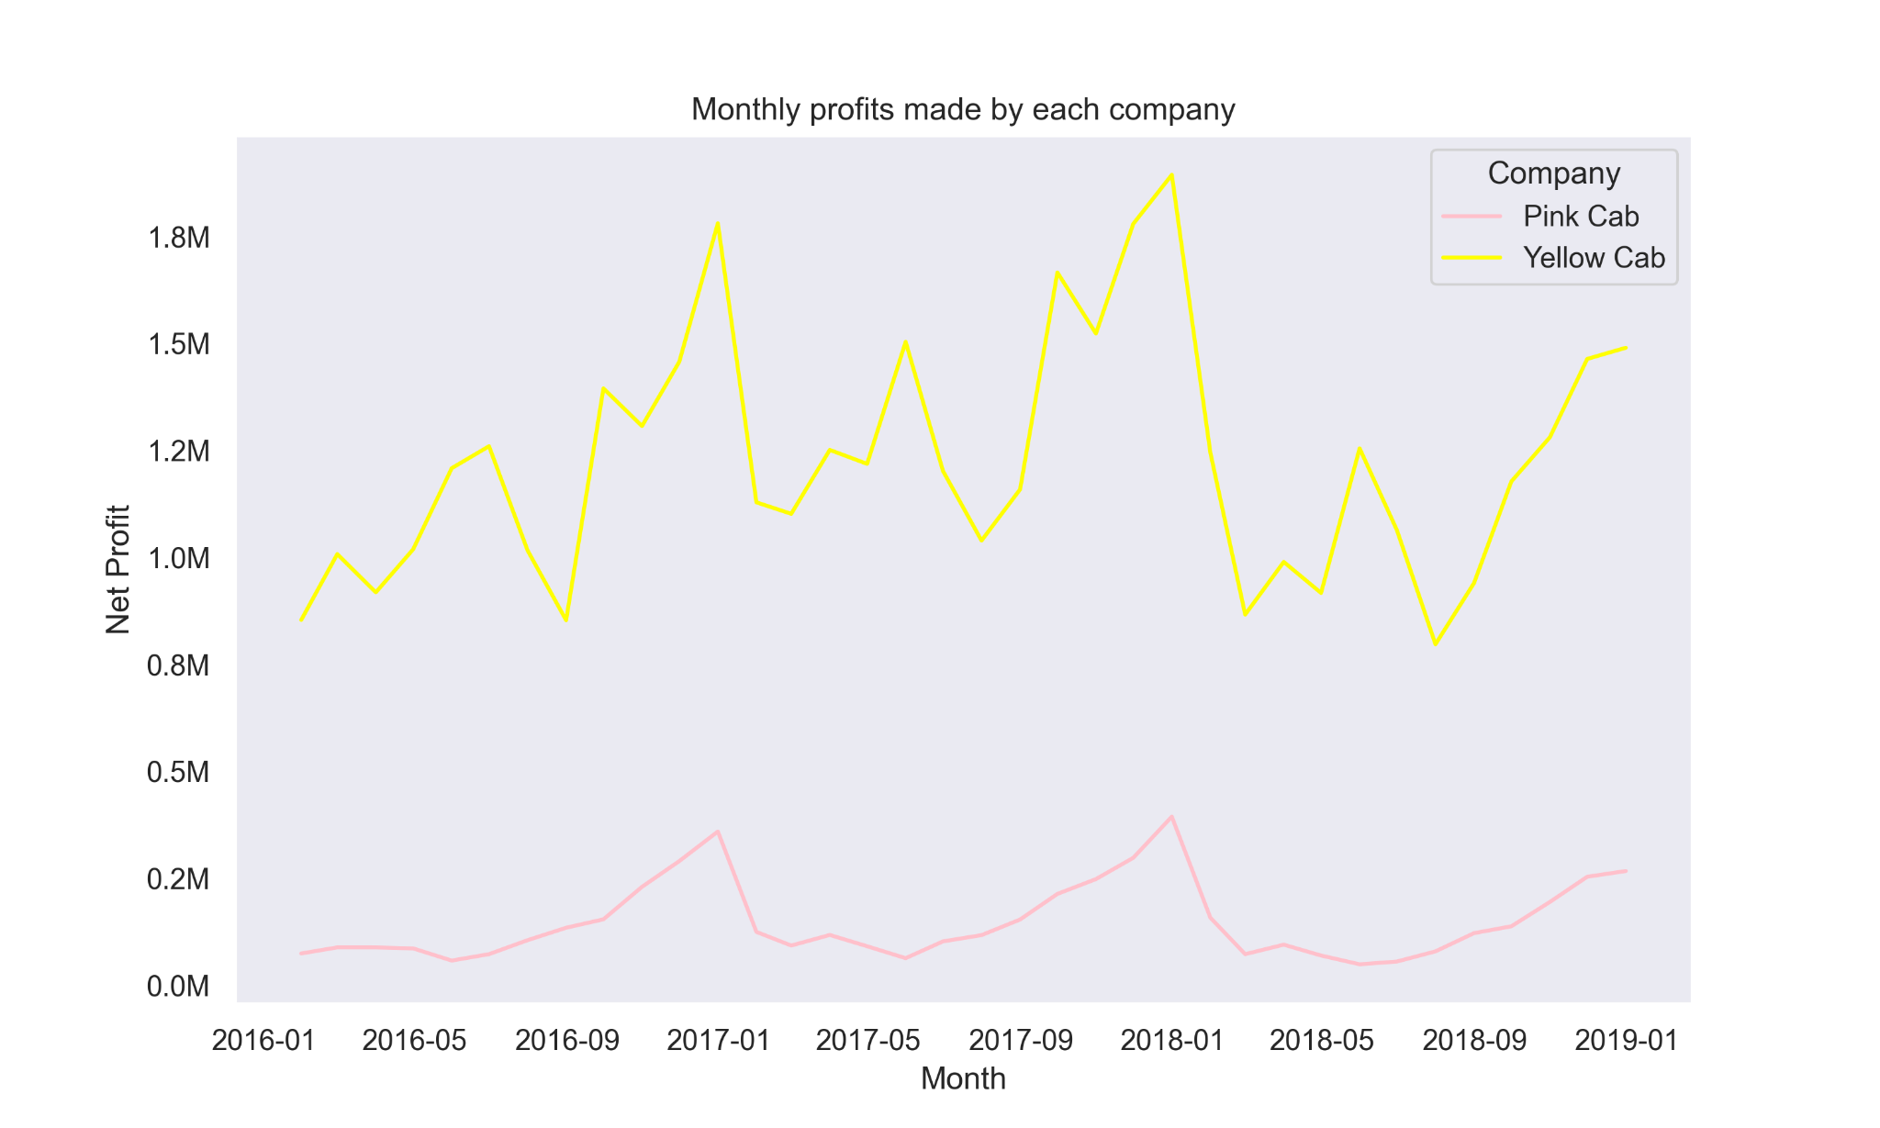
Monthly Revenues by Company
The graph shows Yellow Cab generates much higher monthly profits than its competitor.
Both companies managed to increase their profits at the end of the period.
Despite the inevitable ups and downs in the market, Yellow Cab has managed to maintain a higher profitability, remaining ahead.

Slide 10
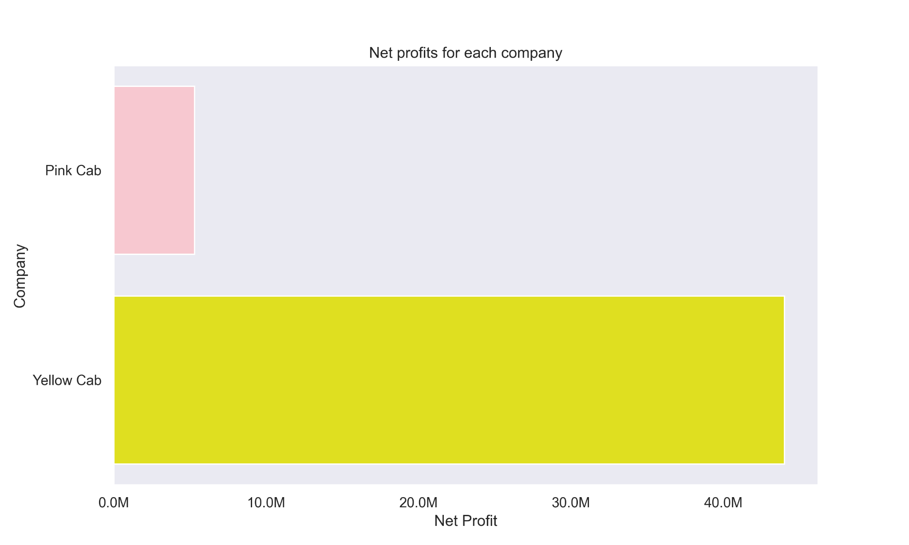
Net Profits by Company
Based on the previous datas, and the current graph it’s not surprising that Yellow Cab generated higher net profit than its competitor Pink Cab.

Slide 11
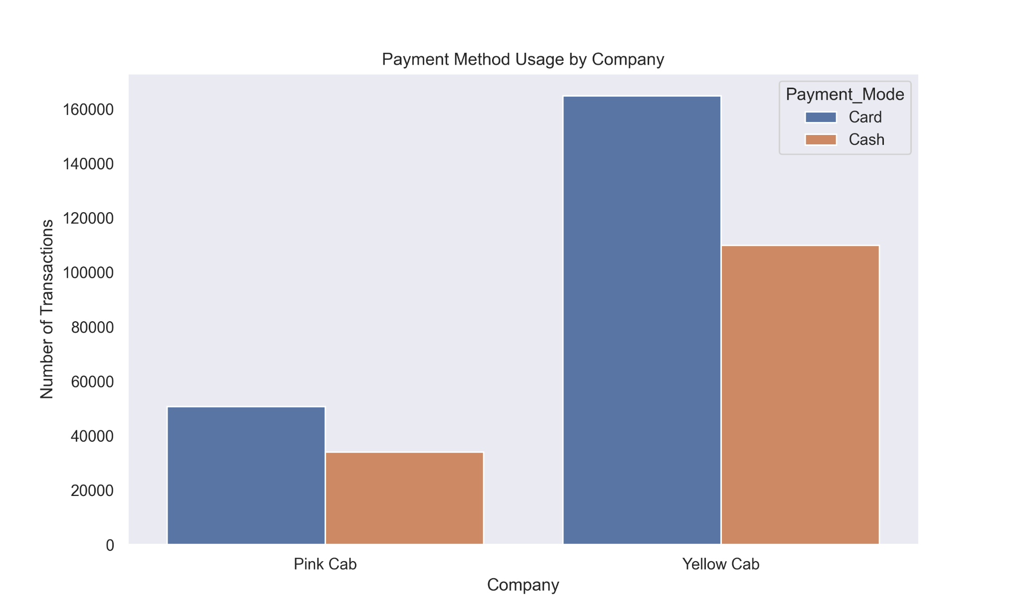
Payment methods used by companies
Based on the current graph, the credit card is the preferred payment method by both companies.
However, more Yellow Cab users prefer cards as a payment method.
Higher card use is essential since it makes adopting new technologies like mobile apps to pay for the services provided to earn loyalty points easier.

Slide 12
Overall Analysis
Since the data provided covers the period between 31/01/2016 and 31/12/2018, it can't be considered a reliable source for making a business decision in 2023. However, even though the unique customer counts are the same for both companies, we can see from the data sets provided that Yellow Cab users used their service more, which resulted in higher profits for the Yellow Cab company. Also, Yellow Cab managed to keep a higher customer retention rate than its competitor, Pink Cab. Yellow Cab has the upper hand regarding future-proof ability since customers use Credit cards to pay more. They can implement more technologies into their company, like a mobile app to call cabs and pay for the services using the app.

Slide 13
Conclusion
Overall, according to data provided and analyzed, Yellow Cab is a better business opportunity than its competitor because of its royal user base, higher profits, and future-proofing.

Slide 14
Thank You

